Slide 1
CMPE 266
Lab – 1 - Programming in R
Team 9
Amita Vasudev Kamat
Kedhara Nethra Thiruvuru
Mohammed Haroon Shareef
Saurabh Gedam

Slide 2
Real Time Data Analytics.
We have chosen San Jose State University – Arrest Crime data to analyze the data.
Data Source - https://ope.ed.gov/campussafety/#/
Data source has the last three years(2014, 2015, 2016) of crime data.

Slide 3
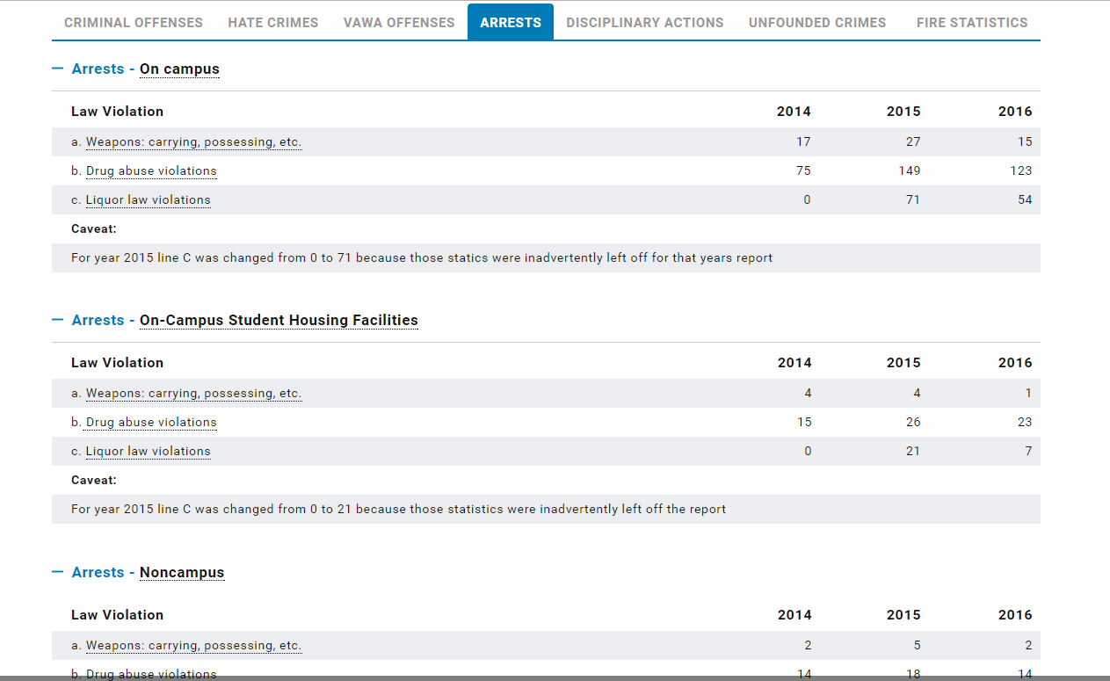
Arrests crime data for SJSU

Slide 4
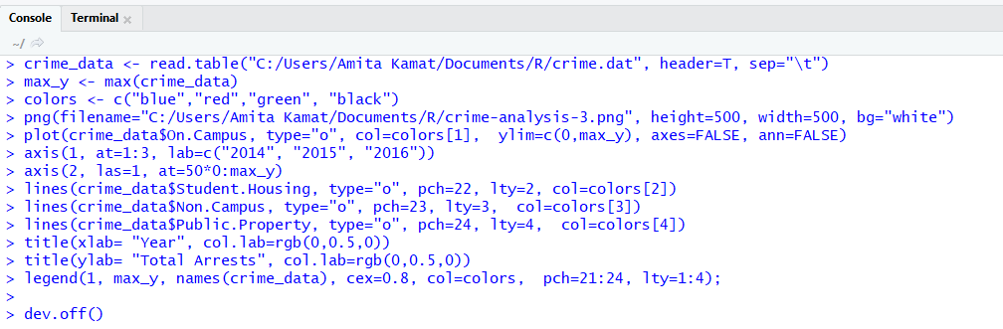
Real Time Data Analytics.
Code Snippet :

Slide 5
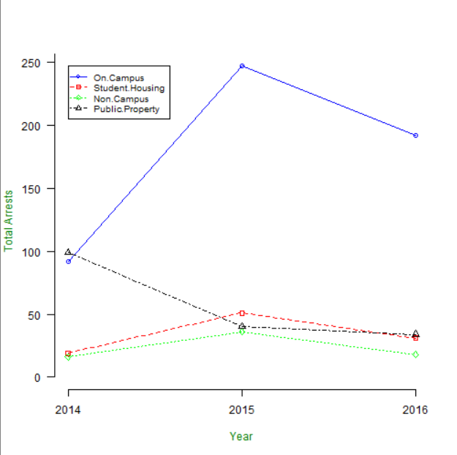
Graph of Crime data analysis

Slide 6
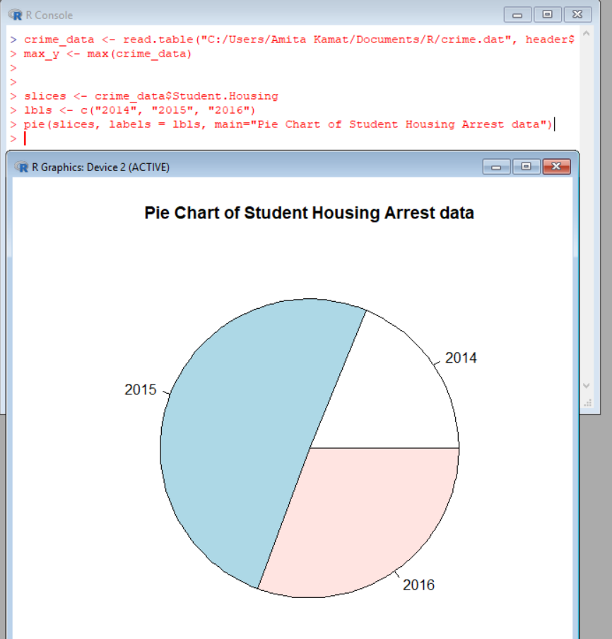
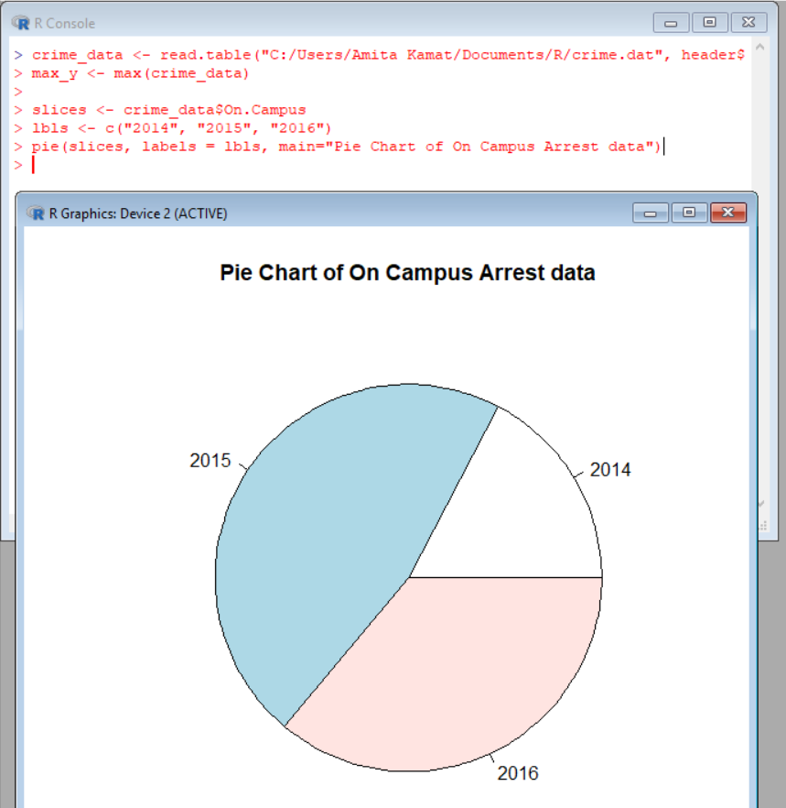
On Campus and Student Housing Crime Pie Chart

Slide 7
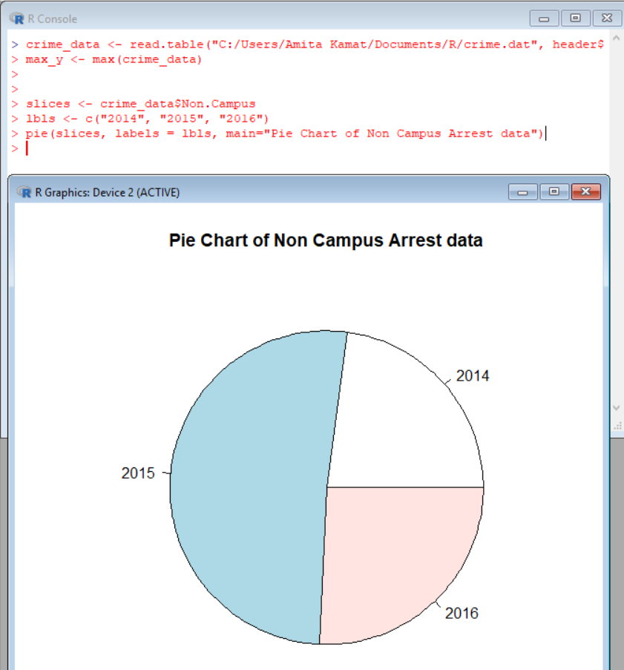
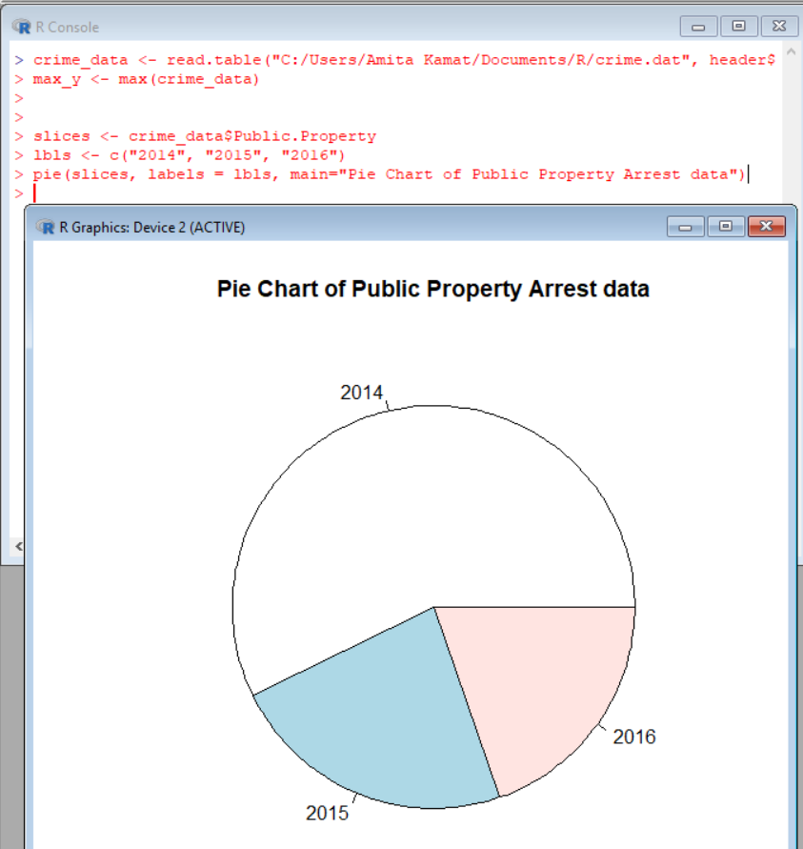
Non Campus and Public Property Crime Pie Chart

Slide 8
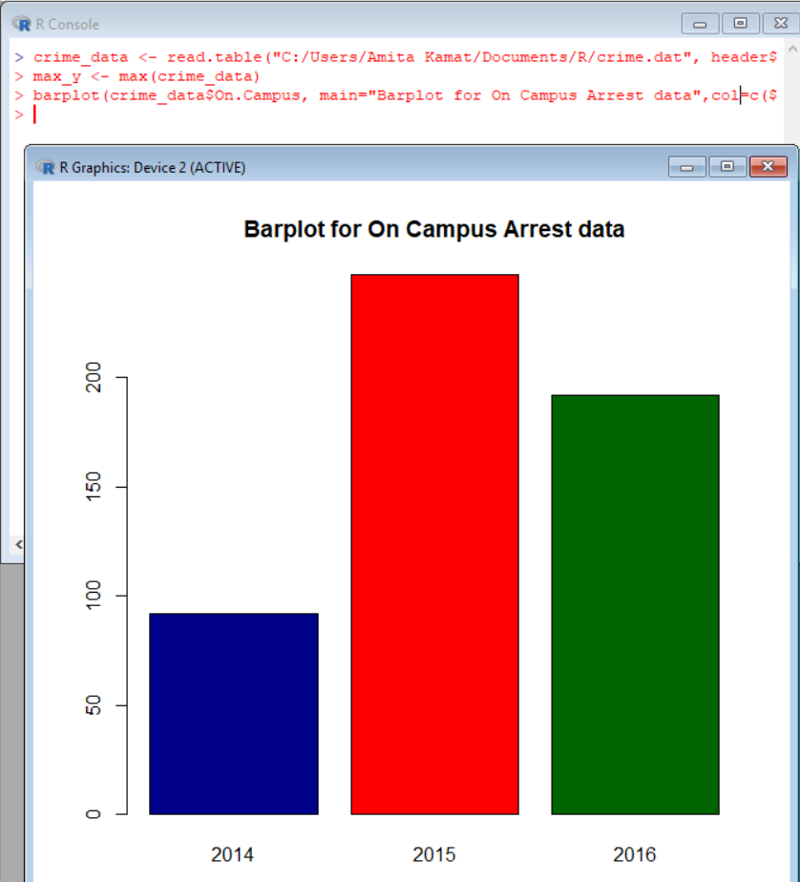
Bar plot for On Campus Arrest data

Slide 9

Real Time Data Analytics.
This Photo by Unknown Author is licensed under CC BY-NC-ND

